Slide 1
A Game of Games
Tyler Bishop, Corbin Hughes,
Andrew Suchanek, Jonathon Holt

Slide 2
User Case (First Release)
Users will be able to select whether or not they want to create a new user or login. If they create a valid new user or login using a current one they will be brought to the menu.
The menu screen consists of a grid of thumbnails. If a thumbnail is clicked a demo screen will pop up as a holder for where games will be.

Slide 3
Use Case (Final Release)
James is a gamer. He has heard of a game that was just released and wants to give it a try.
He launches the game and two options appear to either login or create a new user. He selects create a new user and is prompted to enter a username. The username he enters is already in use so he is asked to enter another one. The second name he enters is available so an entry is made for his specific username in the game that will record his score.
James is then taken to a menu screen that consists of a grid, each element containing a different thumbnail. Each of these thumbnails represents a unique mini-game to be played. The first 3 thumbnails are visible but all the ones after that have a lock symbol above them.
James clicks on the first mini-game and he is brought to a screen and instructed to catch several balls in a cup. James completes the challenge and is returned to the menu where the fourth mini-game in the grid has now had its lock removed and can be accessed to play.
James plays a few more games unlocking subsequent games as well then decides to quit.
Later he returns and this time selects the login option and enters his username from before. The grid is pulled up once again and the mini-games he has previously unlocked are still as such.
Play continues this way until all mini-games are unlocked. Once James has unlocked all the levels they may be replayed in order to obtain high scores.

Slide 4
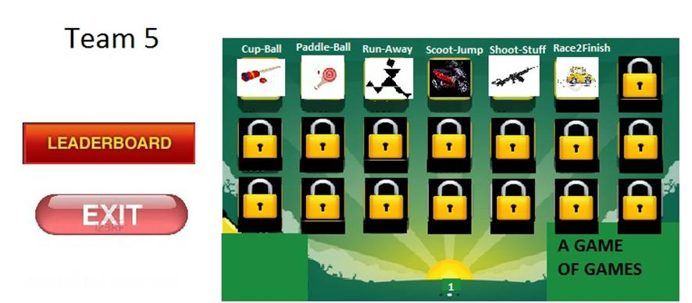
Example Menu

Slide 5
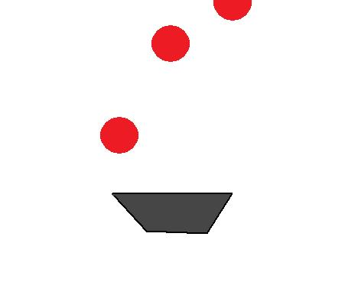
Example Game / Ball in a Cup

Slide 6


Platform / Language

Slide 7

IDE / API / Unit Tester
IDE – Flash CS4 / CS5
API – Box2D (physics)
API – Caurina Tweener (Animations)
Unit Tester – AsUnit

Slide 8
Tasks
Task 1 – Menu Development (2 weeks)
Members – Jon, Tyler
Task 2 – User creation system (2 weeks)
Members – Andrew, Corbin

Slide 9
Log of Meetings
1/24/12 – First Meeting, discussed what game to make and what to develop on/using.
All members present (30 minutes)
1/26/12 – Further discussed game, settled on a platform and language.
All members present (30 minutes)
Presentation coordination done via phone.

